Slide 1



Innovating Philippines’
Digital Financial Infrastructure
Mojaloop Open Source Community Meeting
March 25, 2024
Nairobi, Kenya

Slide 2











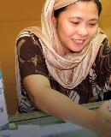






A leading global sustainable development firm transforming life-changing ideas into world changing ones. Where Chemonics works, development works. Work across economic growth and trade, natural resource management, health, and agriculture:
Inclusive Fintech Venture Builder
Present
Cross Border Payments
Social Lending
Insuretech
Freelancer Bank
100
13
75%
36
35
2
Pandemic
Response
Countries
Technical Practice Areas
Local Staff
Years
Projects
Current Projects
2020-
2021
Quarantine Management
Social
Amelioration
2011-
2020
Strategic Transformation
Digital
Banking
Energy Spot
Market
Telco
Transformation
Single Trade
Window
USAID
SPEED
DELIVER
USAID
E-PESO
B+WISER
HRH2030
MENA Lending Platform
Micro Insurance
2001-
2010
Silicon Valley
Startups
Building a Robust and Resilient Digital Economy for the Philippines
Spurring Inclusive Growth in the Philippines
An Alternative to Cash in the Philippines
Saving Biodiversity in the Philippines
Strengthening Human Resources for Health
Worldwide
1998-
2001
13 investments
8 IPOs

Slide 3



Digital Financial Services Landscape
Opportunity to drive digital payments growth and reach unbanked Filipinos
Increasing Share of Digital Payments by Volume
58B
Annual Transaction Volume
$2.34T
44%
Unbanked Filipinos in 2021
Annual Transaction Value
Source: Bangko Sentral ng Pilipinas; Mckinsey
Notes:
Mckinsey BSP

Slide 4

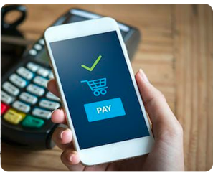
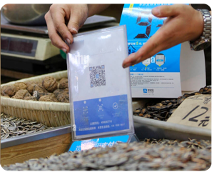
Emerging economics has led to modernizing the payments infrastructure but the modern customers have challenges
Inadequate payments infrastructure
Costly switch fees
Excludes underserved market with high growth potential
Notes:
4.8 bn Volume per month
$195 bn Value per month
Limits merchant services Segmented money movement

Slide 5

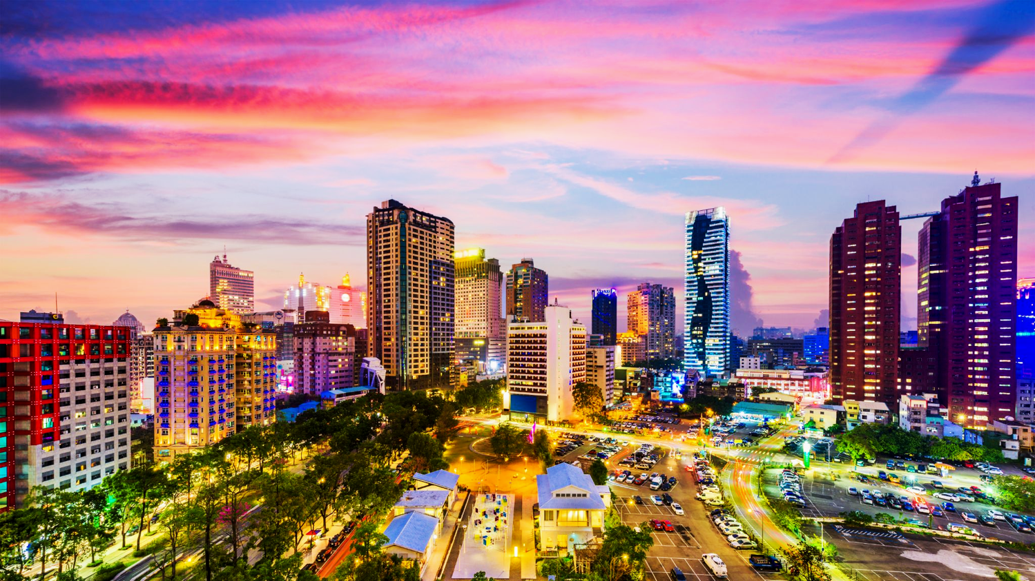










Enable inclusive financial solutions for the underbanked
Rapidly enable of merchants to accept digital Payments
Open participation from all financial institutions (Rural Banks, MFIs)
Modernizing our National Payments Infrastructure
Lower the cost of financial institutions for real time payments
Deliver convenience and security to a mass consumer base

Slide 6




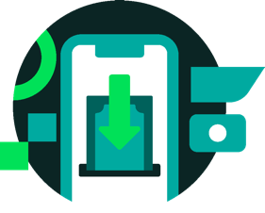
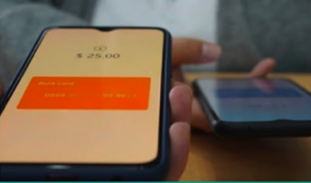

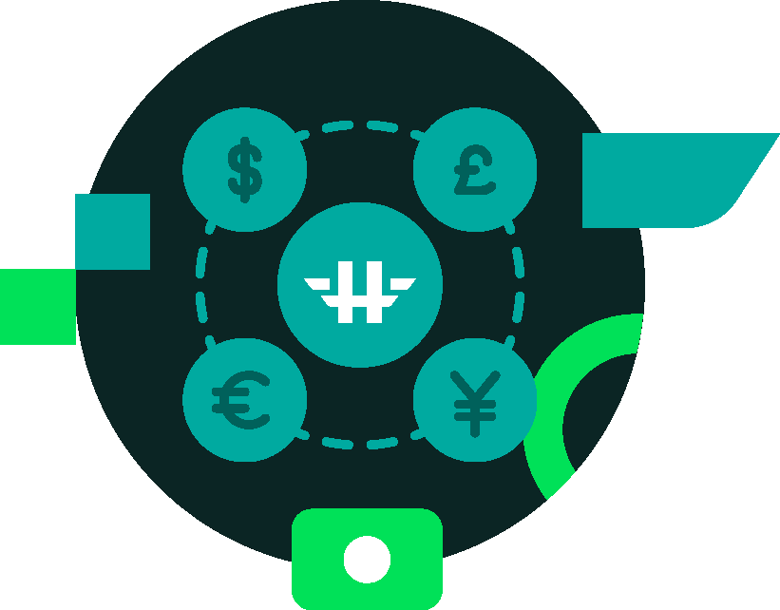

Leverage
Lower the OnRamp barrier to broaden the reach of Financial Institutions
Lower the OnRamp barrier to broaden the reach of Financial Institutions
Open Payments
to provide convenience, security and participation
Lower the Switching Cost for Real-Time Payments and Real-Time Gross Settlements
Lower the Switching Cost for Real-Time Payments and Real-Time Gross Settlements
Modernize the Capability of the Platform to support merchants, innovative payment schemes and cross border payments
Modernize the Capability of the Platform to support merchants, innovative payment schemes and cross border payments
Notes:
Solution

Slide 7



















Neobank
Fintech
Embedded Banking
27% CAGR from 2023 to 2030
3m
600m
Accessibility and Ease of Use
13K
100m
40m
14m
30m
90m
7.4m
Open Payments Platform
Reliability
and Security
Open Payments Platforms enable collaboration between traditional banks and neobanks to make digital payments accessible to everyone.

Slide 8
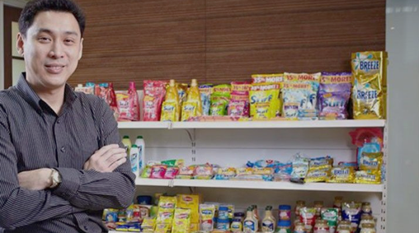












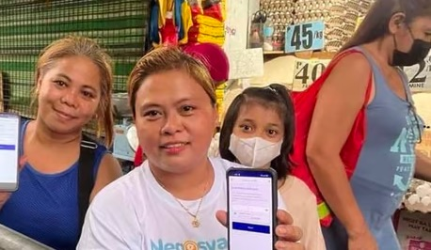




An Open Payments Platform empowering traditional financial institutions to move money and connect new market players in the digital economy
Confidential and for discussion only

Slide 9











Higala connects new players to enter the financial services market, which can lead to better products and services for consumers.
Rural Banks and Thrift Banks
Fintechs
Embedded Banking
Open Payments API
Regulatory Tech
Bank Micro Ledger
Payment
Hub
Global Transaction Gateway
Open Payments Platform
Platform Bank Interface
Leveraging the financial strength of industry leading local banks / Financial institutions through synergistic partnerships
Partner Bank
Digital
Partner Bank
Unibank
Partner Bank
Thrift / Rural

Slide 10















The Higala
Ecosystem
x
Consumers
OFWs
Unibanks
ATMs/POS
Cross-border banks
Account lookup
Enable financial inclusion
Quote
Service
Settlement
Regulatory
and
Compliance
Sari-sari stores
Rural/Thrift Banks
Billers/
Merchants
MSMEs
ISO 20022 Messages

Slide 11










Higala lowers the Cost for Real-Time Payments
Merchants
Payor
Rural
Bank C
Open Payments Platform
Rural
Bank A
Bank A
Bank D
MFIs
Legacy Payments Platform
Connected
Connected
Affiliate Switch Network
Bank F
Fintech
Switch Fee = $0.055
Per transaction
Switch Fee = $0.014
Per transaction
(75% savings)
Rural
Bank B
Bank B
Bank D
e-commerce
Payee
Rural
Bank D
Payee
Notes:
This slide answers how do we do it?
-Introducing a 3rd new option with all of these capabilities
-Faster payments
-Cheaper

Slide 12







Riding the waves of open
payment systems
Launched in 2016
An instant payment system powering multiple bank accounts into one app, leads to huge economic gains:
118B transaction volume in 2023 from 418M in 2017¹
63% of digital transactions are done thru UPI in 2022²
Launched in 2017
A digital payments network, owned by and embedded in the largest banks, allowing seamless transfer
6B+ transaction volume since its inception until 2023
Higher Zelle transaction value at $490B compared to Venmo’ $230B
Launched in 2020
A government-owned and mandated instant payment system, skyrocketed digital payments into:
250% growth in transaction volume in from 2021 to 2023
29% of digital payments in 2023 is made thru Pix and is is expected 40% growth in 2026
The next big wave in Open Payments
Sources: Bangko Sentral ng Pilipinas; Mckinsey
Notes:
Source: International Monetary Fund (2023); Economist (2023)
India: 1 UPI tv, 2 BCG
Pix:3 Pix Brazil, Statista,
Zelle: Z1 + Z2, Zelle

Slide 13

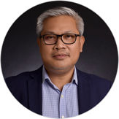
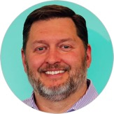

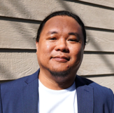
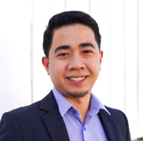

Our Team
Winston Damarillo
Vice Catudio
Jamey Butcher
Talino Venture Studios, CEO Exited three startups in Silicon Valley, Intel Capital, PLDT
Higala Tech, President & CEO
Chief of Party USAID SPEED, CEO Cartera Interchange, USAID E-PESO, USAID SIMM
Chemonics, President & CEO
Global Sustainable Development
Presence in 100+ countries
Francis Plaza
Chief Technology Officer
Dexter Genterone
Chief Architect
Mark Colentava
Product Development
Tonet Quiogue
Partner - Romulo Mabanta

Slide 14
Thank You!
Winston Damarillo
Chairman
Higala Technology, Inc.
wdamarillo@higala.ph
Vice Catudio
Chief Executive Officer
Higala Technology, Inc.
vcatudio@higala.ph
Francis Plaza
Chief Technology Officer
Higala Technology, Inc.
fplaza@higala.ph

